Slide 1
The Business Plan :
Creating and Starting The Venture
(Chapter 7, Entrepreneurship, 6th Edition, 2005
Hisrich, Peters, & Shepherd, McGraw-Hill Irwin)
m@hfuz

Slide 2
What is the Business Plan?
A written document describing all relevant internal and external elements, and strategies for starting a new venture.
It is an integration of functional plans; addresses short-term and long-term decision making for the first three years of operation.
m@hfuz

Slide 3
How do Potential Lenders and Investors Evaluate the Plan?
The business plan must reflect:
  The strengths of management and personnel.
  The product/service.
  Available resources.
Lenders are interested in the venture’s ability to pay back the debt.
  Focus on the four Cs of credit - Character, cash flow, collateral, and equity contribution.
Banks want an objective analysis of the business opportunity and the risks.
m@hfuz

Slide 4
How do Potential Lenders and Investors Evaluate the Plan? (cont.)
Investors, particularly venture capitalists, have different needs:
  Place more emphasis on the entrepreneur’s character.
  Spend much time conducting background checks.
  Demand high rates of return.
  Focus on market and financial projections.
m@hfuz

Slide 5
Presenting the Plan
The entrepreneur is expected to “sell” the business concept.
  Focus on why this is a good opportunity.
  Provide an overview of the marketing program; sales and profits.
  Address risks and how to overcome them.
Audience includes potential investors who may raise questions.
Investors describe these presentations as elevator pitches.
m@hfuz

Slide 6
Information Needs
Before creating a business plan, the entrepreneur must undertake a feasibility study.
Information for a feasibility study should focus on marketing, finance, and production.
Feasible, well-defined goals and objectives need to be established.
  Based on this, strategy decisions can be established.
m@hfuz

Slide 7
Information Needs (cont.)
Operations Information Needs
  Location.
  Manufacturing operations.
  Raw materials.
  Equipment.
  Labor skills.
  Space.
  Overhead.
  Most of the information should be incorporated directly into the business plan.
m@hfuz

Slide 8
Financial Information Needs
The entrepreneur has to prepare a budget of all possible expenditures and revenue sources, including sales and any external available funds.
The budget includes capital expenditures, direct operating expenses, and cash expenditures for nonexpense items.
Industry benchmarks can be used in preparing the final pro forma statements in the financial plan.
m@hfuz

Slide 9
Using the Internet as a Resource Tool
The Internet can provide information for industry analysis, competitor analysis, and measurement of market potential.
It is a valuable resource in later-stage planning and decision making; provides opportunities for marketing strategy.
An entrepreneur can access:
  Popular search engines.
  Competitors’ Web sites.
  Social networks, blogs, and discussion groups.
m@hfuz

Slide 10
Writing the Business Plan
A business plan should be comprehensive enough to give any potential investor a complete picture and understanding of the new venture.
It should help the entrepreneur clarify his or her thinking about the business.
m@hfuz

Slide 11
Writing the Business Plan (cont.)
Introductory Page
  Name and address of the company.
  Name of the entrepreneur(s), telephone number, fax number, e-mail address, and Web site address.
  Description of the company and nature of the business.
  Statement of financing needed.
  Statement of confidentiality of report.
m@hfuz

Slide 12
Writing the Business Plan (cont.)
Executive Summary
  About two to three pages in length summarizing the complete business plan.
Environmental and Industry Analysis
  The environmental analysis assesses external uncontrollable variables that may impact the business plan.
    Examples: Economy, culture, technology, legal concerns, etc.
  The industry analysis involves reviewing industry trends and competitive strategies.
    Examples: Industry demand, competition, etc.
m@hfuz

Slide 13
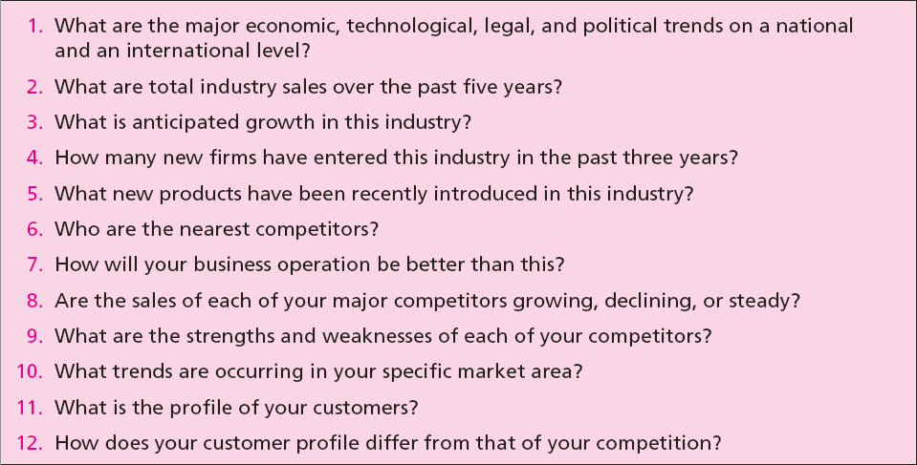
Table 7.5 - Critical Issues for
Environmental and Industry Analysis
m@hfuz

Slide 14
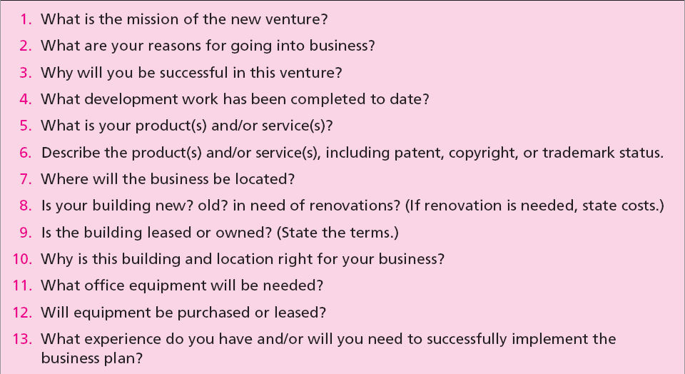
Table 7.6 - Describing the Venture
m@hfuz

Slide 15
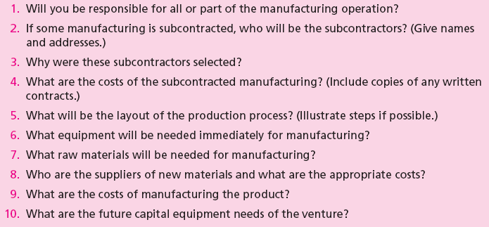
Table 7.7 - Production Plan
m@hfuz

Slide 16
Writing the Business Plan (cont.)
Operations Plan
  All businesses (manufacturing or nonmanufacturing) should include an operations plan as part of the business plan.
  It goes beyond the manufacturing process.
  Describes the flow of goods and services from production to the customer.
  The major distinction between services and manufactured goods is services involve intangible performances.
m@hfuz

Slide 17
Writing the Business Plan (cont.)
Marketing Plan
  It describes market conditions and strategy related to how the product/service will be distributed, priced, and promoted.
  Marketing research evidence to support any of the marketing decision strategies as well as for forecasting sales should be described in this section.
  Potential investors regard the marketing plan as critical to the success of the new venture.
m@hfuz

Slide 18
Writing the Business Plan (cont.)
Organizational Plan
  It describes the form of ownership and lines of authority and responsibility of members of new venture.
  In case of a partnership, the terms of the partnership should be included.
  In case of a corporation, the following should be included:
    Shares of stock authorized and share options.
    Names, addresses, and resumes of directors and officers.
    Organization chart.
m@hfuz

Slide 19
Writing the Business Plan (cont.)
Assessment of Risk
  Identifies potential hazards and alternative strategies to meet goals and objectives.
  The entrepreneur should indicate:
    Potential risks to the new venture.
    Impact of the risks.
    Strategy to prevent, minimize, or respond to the risk.
  Major risks could result from:
    Competitor’s reaction.
    Weaknesses in marketing/ production/ management team.
    New advances in technology.
m@hfuz

Slide 20
Writing the Business Plan (cont.)
Financial Plan
  It contains projections of key financial data that determine economic feasibility and necessary financial investment commitment.
  It should contain:
    Summarized forecasted sales and appropriate expenses for at least the first three years.
    Cash flow figures for three years.
    Projected balance sheet.
m@hfuz

Slide 21
Writing the Business Plan (cont.)
Appendix
  It contains any backup material that is not necessary in the text of the document.
  It may include:
    Letters from customers, distributors, or subcontractors.
    Secondary data or primary research data used to support plan decisions.
    Leases, contracts, or other types of agreements.
    Price lists from suppliers and competitors.
m@hfuz

Slide 22
Why Some Business Plans Fail!!
Goals are unreasonable.
Objectives are not measurable.
Entrepreneur has not made a total commitment to the business or to the family.
Lack of experience in the planned business.
No sense of potential threats or weaknesses to the business.
No customer need was established for the proposed product or service.
m@hfuz

Slide 23
Questions and Comments
m@hfuz

Slide 24
Thank You
m@hfuz

